Slide 1


Slide 2
What is Nginx ?
Nginx is an web server.
Used to serve static files.
100 out of 35% websites all over the world use Nginx.
Officially released in October d2004.
It was created to solve the problem of c10k
Port no : 80
It is easy to install and Open source.

Slide 3
Advantages ?
It uses less memory and resources.
Nginx make the website faster.
It helps to get better ranking on Google (SEO).
Can handling thousands of Connection same time.
Load balancing.
Acts a Proxy and Reverse Proxy.

Slide 4
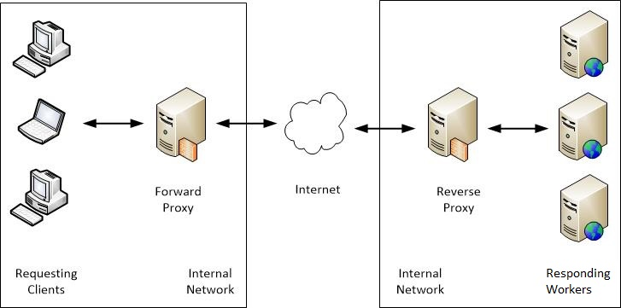
Proxy ?

Slide 5
Advantages of Proxy ?
Hide a client’s Ip Address.
Protect data and resources from malicious activity.
Can restrict access to the users/groups.
Speed results from cashe.

Slide 6
Installation :
apt install nginx : to install nginx service
systemctl start nginx : to start the service
systemctl status nginx

Slide 7
Important path :
cd /var/www/html
tail -f /var/log/nginx/access.log
tail -f /var/log/nginx/access.log | awk ‘{print $1}’:
tail -f /var/log/nginx/access.log | awk '{print $1}'

Slide 8
Block an IP (e.g. 192.168.1.100) from accessing your Nginx website
Step 1: Open your Nginx config file
You can block an IP in:
The main site config (usually inside /etc/nginx/sites-available/)
Or directly inside the nginx.conf (not recommended for per-site blocks)
Example for a site:
bash
sudo nano /etc/nginx/sites-available/default
(Replace default with your site file like mydomain.com if using virtual hosts.)

Slide 9
Step 2: Add the deny rule
Inside the server block or location / block, add:
nginx
deny 192.168.1.100;
Example inside a server block:
nginx
server { listen 80; server_name yourdomain.com;
root /var/www/html;
index index.html;
#Block this IP
deny 192.168.1.100;
location / { try_files $uri $uri/ =404; } }
✅ You can also allow and deny:
nginx
allow all;
deny 192.168.1.100;
Nginx reads rules top to bottom.
allow all;
deny 192.168.1.100;

Slide 10
Step 3: Save and test Nginx config
Check syntax:
bash
sudo nginx -t
✅ You should see:
bash
nginx: configuration file /etc/nginx/nginx.conf test is successful
✅ Step 4: Reload Nginx
To apply the new rules:
bash
sudo systemctl reload nginx

Slide 11
To Block Multiple IPs:
Add multiple deny lines:
nginx
deny 192.168.1.100;
deny 203.0.113.45;

Slide 12
Step | Command
Edit config | sudo nano /etc/nginx/sites-available/default
Add IP block | deny 192.168.1.100; inside server or location
Test config | sudo nginx -t
Reload Nginx | sudo systemctl reload nginx

Slide 13
#! /bin/bash
yum install httpd git -y
systemctl start httpd
systemctl status httpd
cd /var/www/html
git clone https://github.com/karishma1521success/swiggy-clone.git
mv swiggy-clone/* .
tail -100f /var/log/httpd/access_log

Slide 14
tail -f /var/log/nginx/access.log | awk '{print $1}'

